Slide 1
Introduction to Model Compression and Acceleration for DNNs
Jinbo wang
July 10,2019

Slide 2
Intro
Edge Computing
Why
computationally expensive and memory intensive(VGG-16,500MB,15B FLOPs) hindering their deployment in embedded and mobile device with low memory resources and constrained download bandwidth or in applications with strict latency requirements(RS,50ms)
energy consumption is dominated by memory access

Slide 3
Goal
perform model compression and acceleration in deep networks without significantly decreasing the model performance ( accuracy )
fitting the model into on-chip SRAM cache rather than off-chip DRAM memory
Application
real-time applications such as online learning and incremental learning, virtual reality, augmented reality, and smart wearable devices ,auto drive,

Slide 4
Categories
low-rank approximation:Using matrix/tensor decomposition to estimate the informative parameters
network quantization(filter num):make the parameters tend to be sparse by adding items in the loss function
knowledge distillation:Training a compact neural network with distilled knowledge of a large model
hardware accelerator:FPGA/ASIC
compact network design:MobileNet,ShuffleNet
network pruning and sharing(filter weight):Reducing redundant parameters which are not sensitive to the performance
software optimization(HPC):Tensorrt(FP16,INT8 activation value fixed-pointer quantization),TVM

Slide 5
Topic
compact network design:MobileNet,ShuffleNet
network pruning and sharing:Reducing redundant parameters which are not sensitive to the performance(模型压缩：参数稀疏、剪裁、量化、分解)
software optimization(HPC):Tensorrt(FP16,INT8)

Slide 6
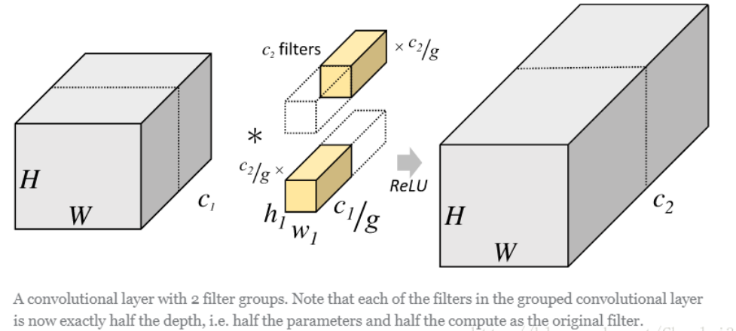
Compact network design
Group conv
Conv:256×3×3×256
Group conv:8×32×3×3×32

Slide 7
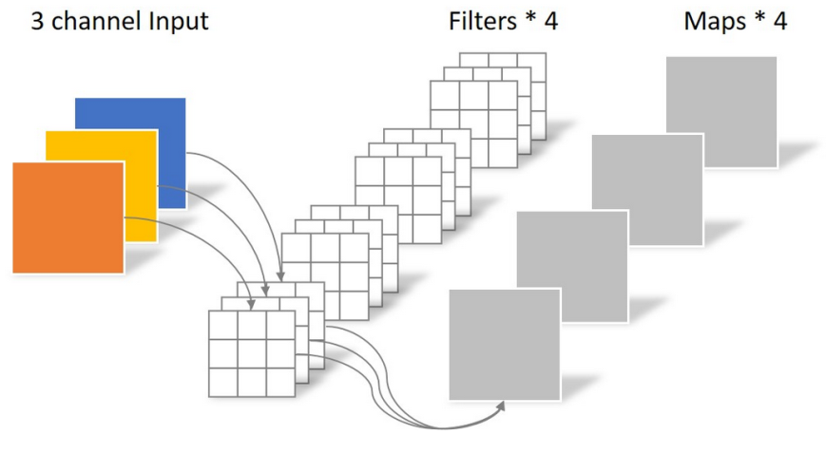
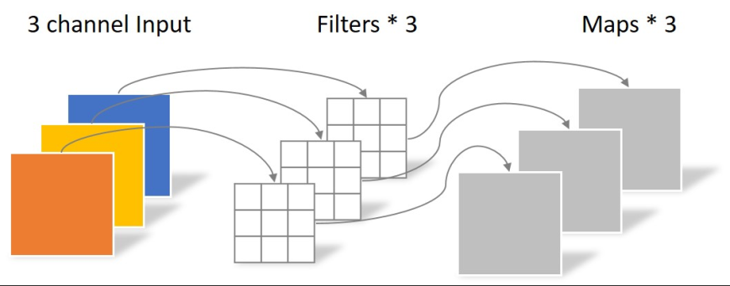
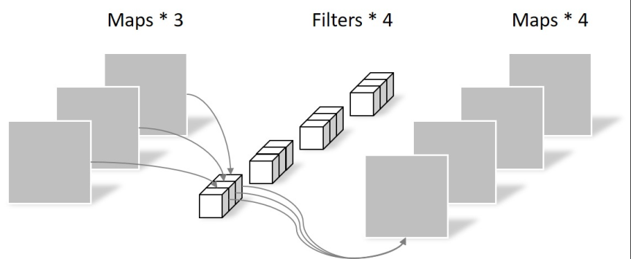
Compact network design
Conv: 4 × 3 × 3 × 3 = 108
Depthwise Conv : 3 × 3 × 3 = 27
Pointwise Conv : 1 × 1 × 3 × 4 = 12

Slide 8
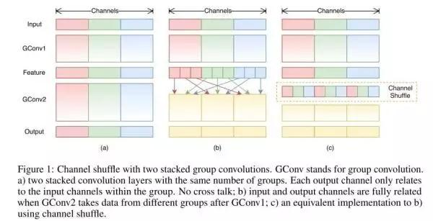
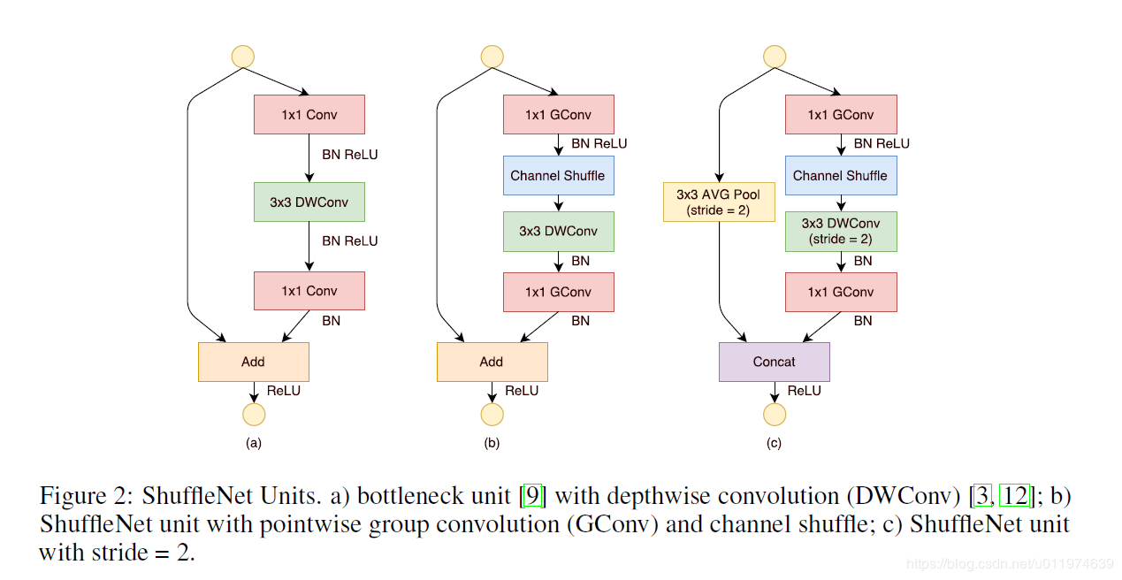
Compact network design:ShuffleNet

Slide 9
Network pruning and sharing
DEEP COMPRESSION:COMPRESSING DEEP NEURAL NETWORKS WITH PRUNING,TRAINED QUANTIZATION AND HUFFMAN CODING(best paper 2016)
Result：
AlexNet by 35X, from 240MB to 6.9MB, VGG-16 by 49X from 552MB to 11.3MB without loss of accuracy.
3X to 4X layerwise speedup and 3X to 7X better energy efficiency

Slide 10
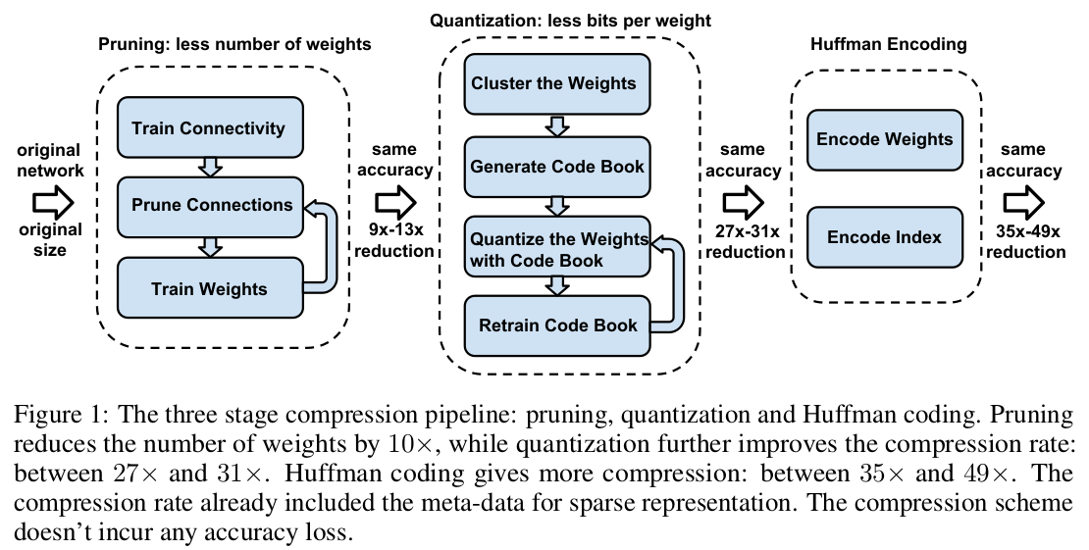
The three stage compression pipeline
Weights->codebook(effective weights after k-means)->quantize wights
还需要存储索引 groupby

Slide 11
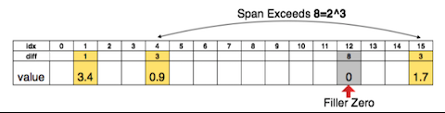
Network Pruning
proved to be a valid way to reduce the network complexity and over-fitting
prune the small-weight connections below a threshold
store the sparse structure using CSR or CSC format
store the index difference instead of the absolute position, and encode this difference in 8 bits for conv layer and 5 bits for fc layer.
When we need an index difference larger than the bound, we the zero padding solution shown in Figure 2: in case when the difference exceeds 8, the largest 3-bit (as an example) unsigned number, we add a filler zero
16 ∗ 32/(4 ∗ 32 + 2 ∗ 16) = 3.2 (4*4filter每个位置属于4 (2bits)个聚类（codebook，effctive weight）中的哪一组
Notes:
store the index difference instead of the absolute position, and encode this difference in 8 bits for conv layer and 5 bits for fc layer.
When we need an index difference larger than the bound, we the zero padding solution shown in Figure 2: in case when the difference exceeds 8, the largest 3-bit (as an example) unsigned number, we add a filler zero
16 ∗ 32/(4 ∗ 32 + 2 ∗ 16) = 3.2

Slide 12
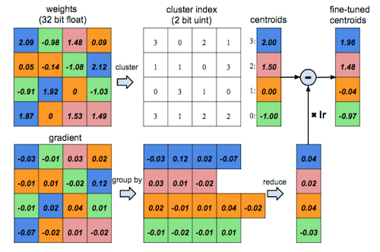
Network quantization and weight sharing
reducing the number of bits required to represent each weight and limit the number of effective weights(and fine-tune) : share the same weight(k-means)

Slide 13
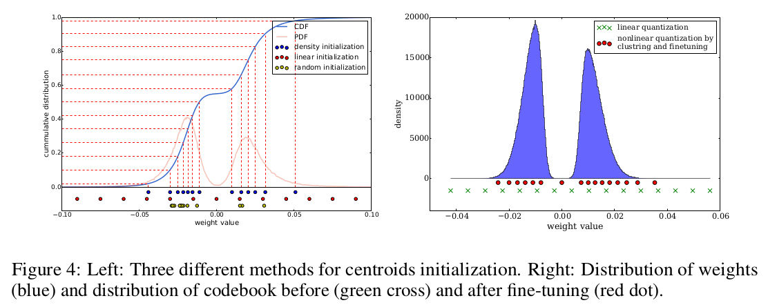
K-means:centroid initialization
larger weights play a more important role, but there are fewer large weights:more centroids have large absolute value
Linear initialization :尽量包含所有的范围，密度大的地方压缩效率越高，越是我们想要的
center

Slide 14
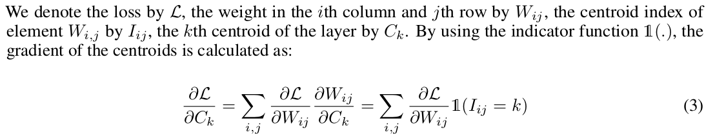
FORWARD AND B ACK - PROPAGATION
There is one level of indirection during feed forward phase and back-propagation phase looking up the weight table.An index into the shared weight table is stored for each connection

Slide 15
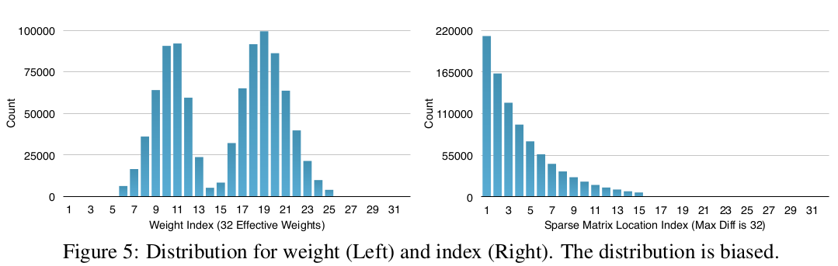
Huffman(lossless data compress) Coding
The table is derived from the occurrence probability for each symbol. More common symbols are represented with fewer bits(variable-length codewords)

Slide 16
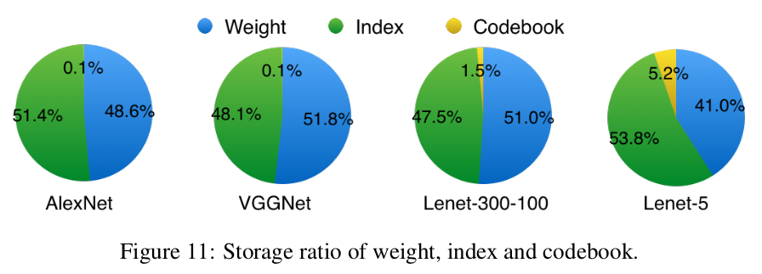

Slide 17
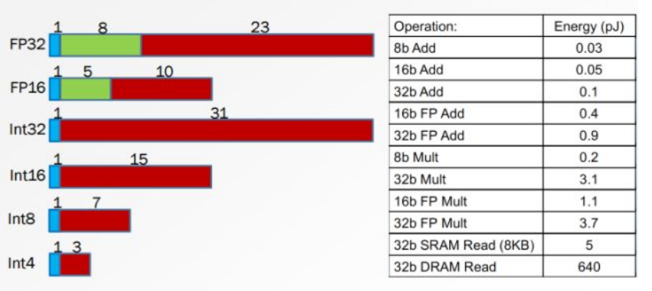
Software optimization
Goal: Convert into FP32,FP16,INT8
higher throughput, lower memory and Low energy consumption requirements.

Slide 18
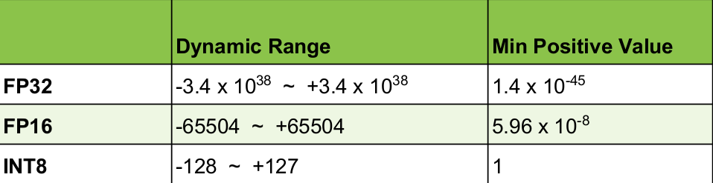
Software optimization
Challenge: significantly lower precision and dynamic range

Slide 19
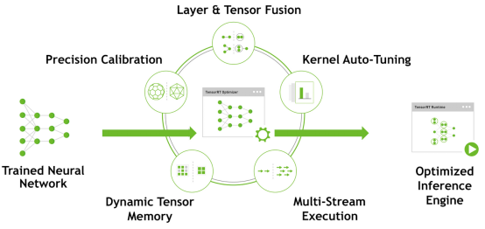
TensorRT optimizes trained DNNs to produce adeployment-ready runtime inference engine

Slide 20
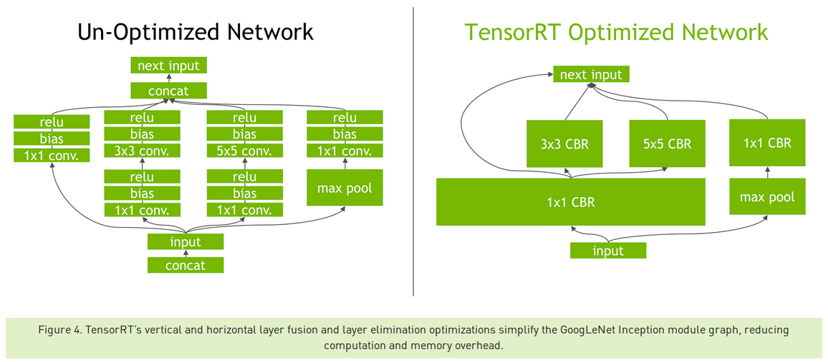
Layer and tensor fusion and elimination of unused layers

Slide 21
FP16 and INT8 Precision Calibration:Tensor Values = FP32 scale factor * int8 array + FP32 bias
Kernel Auto-Tuning: convolutions, pick the implementation from a library of kernels that delivers the best performance for the target GPU
Dynamic Tensor Memory :improves memory reuse by designating memory for each tensor only for the duration of its usage, avoiding memory allocation overhead for fast and efficient execution.

Slide 22
Symmetric linear quantization
Do we really need bias? No!
Q: How to optimize threshold selection? Saturate above |threshold| to 127
During the optimization phase TensorRT also chooses from hundreds of specialized kernels, many of them hand-tuned and optimized for a range of parameters and target platforms. As an example, there are several different algorithms to do convolutions. TensorRT will pick the implementation from a library of kernels that delivers the best performance for the target GPU, input data size, filter size, tensor layout, batch size and other parameters.

Slide 23
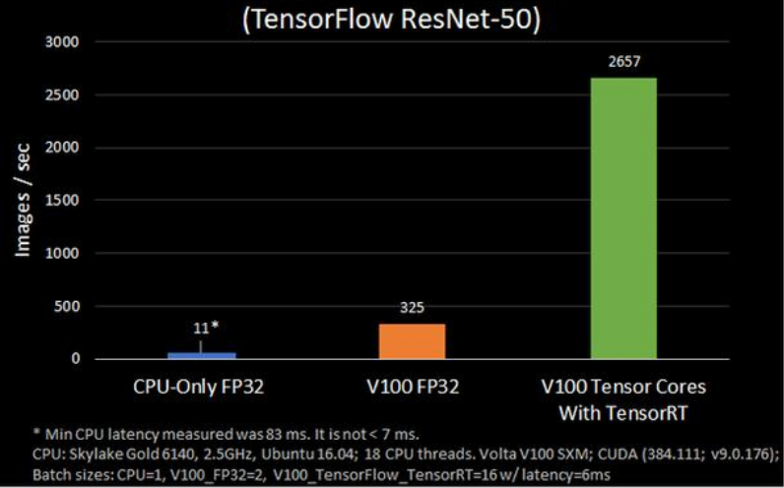
Result

Slide 24
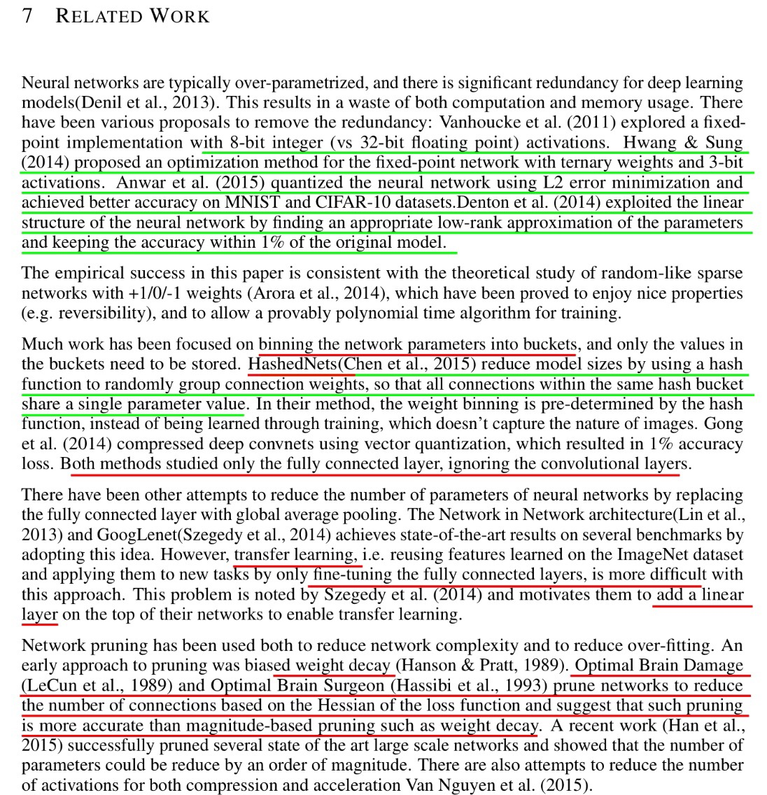

Slide 25
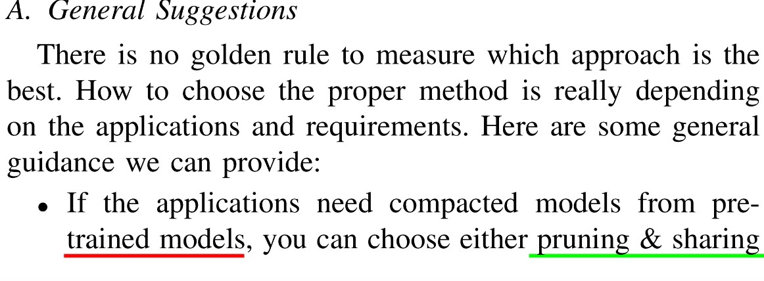

Slide 26
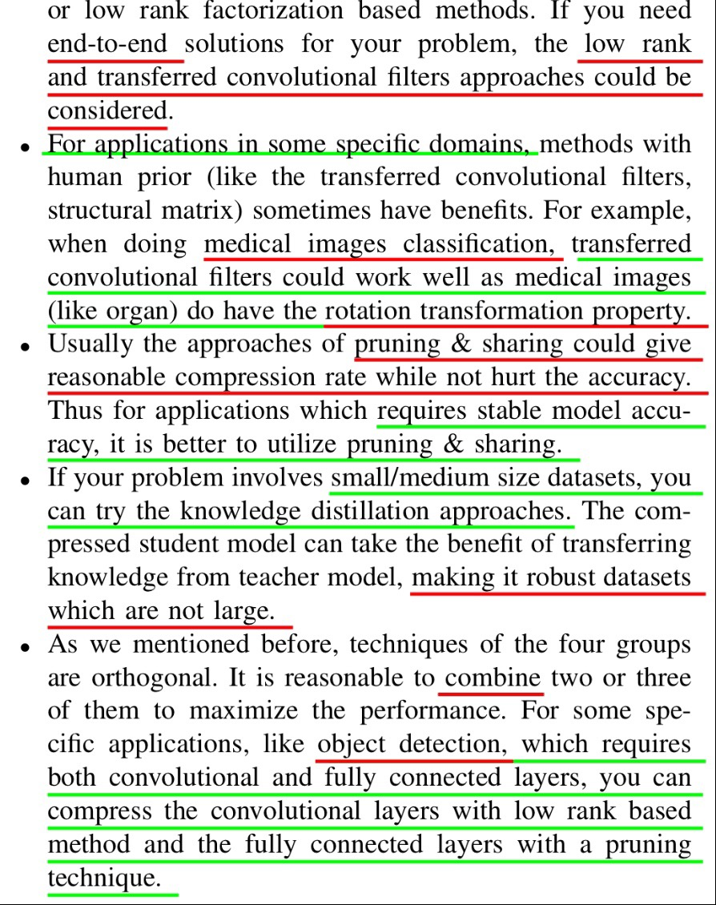

Slide 27
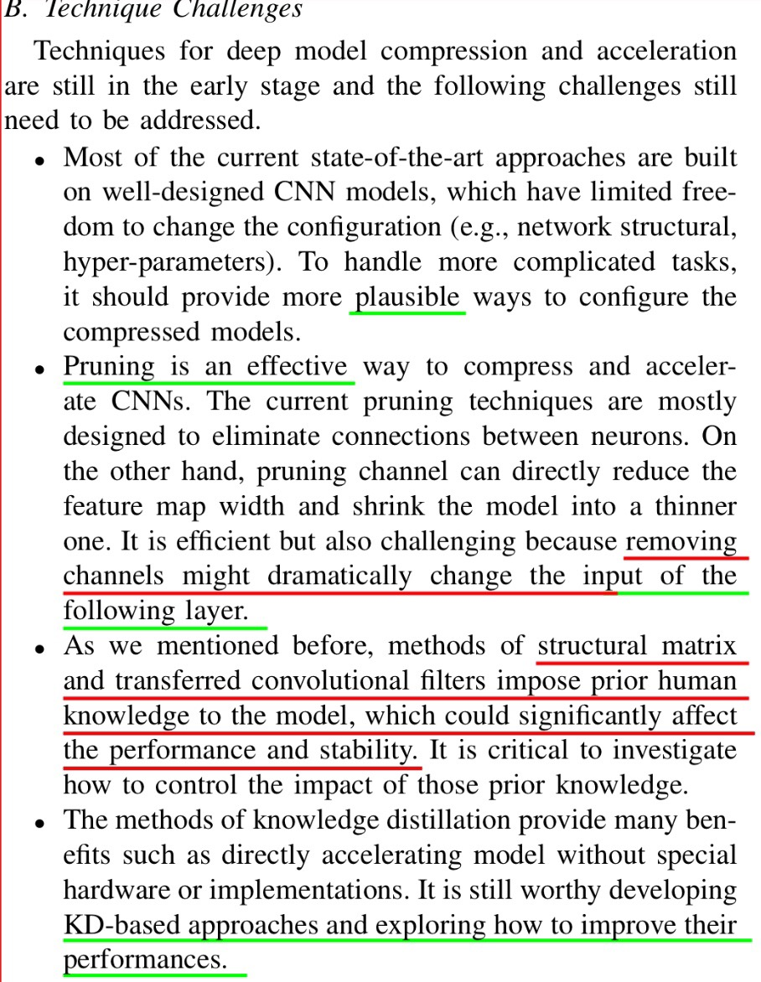

Slide 28
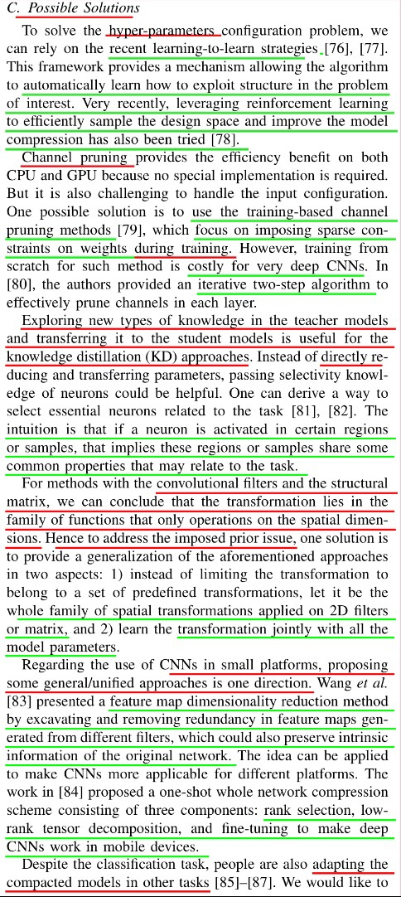

Slide 29
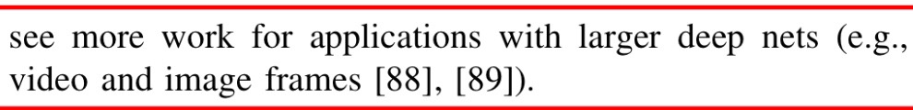

Slide 30
Discussion
While the pruned network has been benchmarked on various hardware, the quantized network with weight sharing has not, because off-the-shelf cuSPARSE or MKL SPBLAS library does not support indirect matrix entry lookup, nor is the relative index in CSC or CSR format supported. So the full advantage of Deep Compression that fit the model in cache is not fully unveiled. A software solution is to write customized GPU kernels that support this. A hardware solution is to build custom ASIC architecture specialized to traverse the sparse and quantized network structure, which also supports customized quantization bit width. We expect this architecture to have energy dominated by on-chip SRAM access instead of off-chip DRAM access.

Slide 31
suggestions
Pruning and sharing :get reasonable compression rate with no accurancy loss???
pre-trained models, you can choose either pruning & sharing,low rank;low rank and transferred conv filters is end-to-end solution
Special domain:medical images classification transterred filter(have rotation transformation property)
KD
Object detection:conv layer :low rank;fc :pruning

Slide 32
challenges
Channel pruning may change the input of following layer;
structural matrix and transferred convolutional filters impose prior human knowledge to the model, which could significantly affect the performance and stability.
KD-based approaches and exploring how to improve their performances.

Slide 33
Trends
None-fine-tuning or unsupervised compression
Hyperparameters(pruning,low rank,bitwidth of fixed-point quantization)
Object detection
Hardware-software co-design

Slide 34
Reference
Recent Advances in Efficient Computation of Deep Convolutional Neural Networks
DEEP COMPRESSION : COMPRESSING DEEP N EURALN ETWORKS WITH PRUNING , TAINED Q UANTIZATIONAND HUFFMAN CODING
https://github.com/Ewenwan/Caffe-Python-Tutorial/blob/master/quantize.py
https://github.com/Ewenwan/quantized-cnn
https://docs.nvidia.com/deeplearning/sdk/tensorrt-developer-guide

Slide 35
Thanks

